Slide 1

Green Pace
Security Policy Presentation
Developer: Jon Way

Slide 2

OVERVIEW: DEFENSE IN DEPTH
Defense-in-depth for C/C++ languages
Code, personnel, on premise security

Slide 3
THREATS MATRIX
The threats identified have been sorted here by probability and priority. High priority items should be dealt with first, followed by likely items, then low priority, then unlikely.
Likely Data Value Memory Protection Integer Functions | Priority String Correctness SQL Injection Memory Management String Pointers
Low priority Exceptions | Unlikely Data type Assertions

Slide 4
10 PRINCIPLES
Validate Input Data: Data Type, Data Value, String Correctness, SQL Injections, Memory Protection, Memory Management, String Pointers, Integer Functions
Heed Compiler Warnings: Exceptions
Architect and Design for Security Policies
Keep It Simple
Default Deny
Adhere to the Principle of Least Privilege
Sanitize Data Sent to Other Systems: SQL Injections
Practice Defense In Depth
Use Effective Quality Assurance Techniques: Assertions
Adopt a Secure Coding Standard

Slide 5
CODING STANDARDS
Data Type: Use proper data type declarations and be aware of conversions that could introduce errors.
Data Value: Ensure that integer conversions don’t result in lost data.
String Correctness: Guarantee there is sufficient space for string storage.
SQL Injection: Prevent SQL Injection by sanitizing and validating queries.
Memory Protection: Free dynamically allocated memory when no longer needed
Assertions: Don’t leave assertions in production code.
Exceptions: Use exceptions to catch errors.
Memory Management: Do not access freed memory.
String Pointers: Do not attempt to create a string from a null pointer
Integer Functions: Ensure that division and remainder operations do not result in divide-by-zero errors.

Slide 6
ENCRYPTION POLICIES
Encryption at Rest – data that is stored
Encryption in Flight – data that is being transferred
Encryption in Use – data that is being accessed

Slide 7
TRIPLE-A POLICIES
Authentication – verify who is accessing information
Authorization – verify that this person is allowed to access this information
Accounting – who/what/when/where/why/how

Slide 8
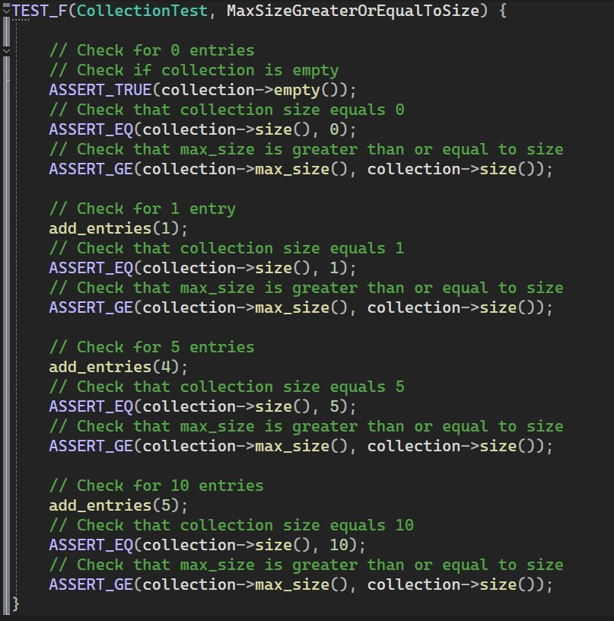
Unit Testing
Tests run included checking if the max collection size was greater than or equal to the size of the collection, verifying that the collection could be cleared, verifying that exceptions would be thrown if an entry was out of range, and many more

Slide 9

AUTOMATION SUMMARY

Slide 10
TOOLS
DevSecOps Pipeline refers to the integration of security into your software development lifecycle.
Examples of automation tools:
Cppcheck – used throughout to find vulnerabilities in code that even IDE's might not catch
Parasoft C/C++test – helps check code for vulnerabilities during "Verify and Test" stage as well as "Maintain and Stabilize" stage

Slide 11
RISKS AND BENEFITS
"Don't Leave Security Until The End" is a best practice in coding
Ensures checking for errors throughout process
Catches vulnerabilities sooner than at the end of development
Waiting can result in increased costs, time for development, loss of client and customer trust

Slide 12
RECOMMENDATIONS
This guide is a living document that should be updated and amended as necessary for best security practices
Coding standards ensure that the development team produce a product that is consistent no matter who works on what sections of the application
While initial document focuses highly on code standards, other areas of security should be addressed as well to line up with the 10 principles
Security at a company level – user credentials, security
Employee training

Slide 13
CONCLUSIONS
Address facility security
Address employee security
Continue to monitor code as programs evolve

